Slide 1

Building an OS from Scratch: Bridging Theory & Practice
A hands-on approach to understanding Operating Systems.
Notes:
1

Slide 2
THE PROBLEM
The Gap Between OS Theory and Practice
Learners often grasp operating system concepts like process management and memory handling in theory, but lack practical experience in implementation. Full-scale operating systems are too complex for isolated study, leading to a limited understanding of fundamental system-level mechanics.
Abstract Concepts
Complexity Barrier
Limited Application
Theoretical learning often keeps OS concepts abstract, hindering deep comprehension.
Real-world OS kernels are too intricate for beginners to dissect and understand.
Without hands-on experience, applying OS knowledge to practical problems is challenging.
Notes:
2

Slide 3
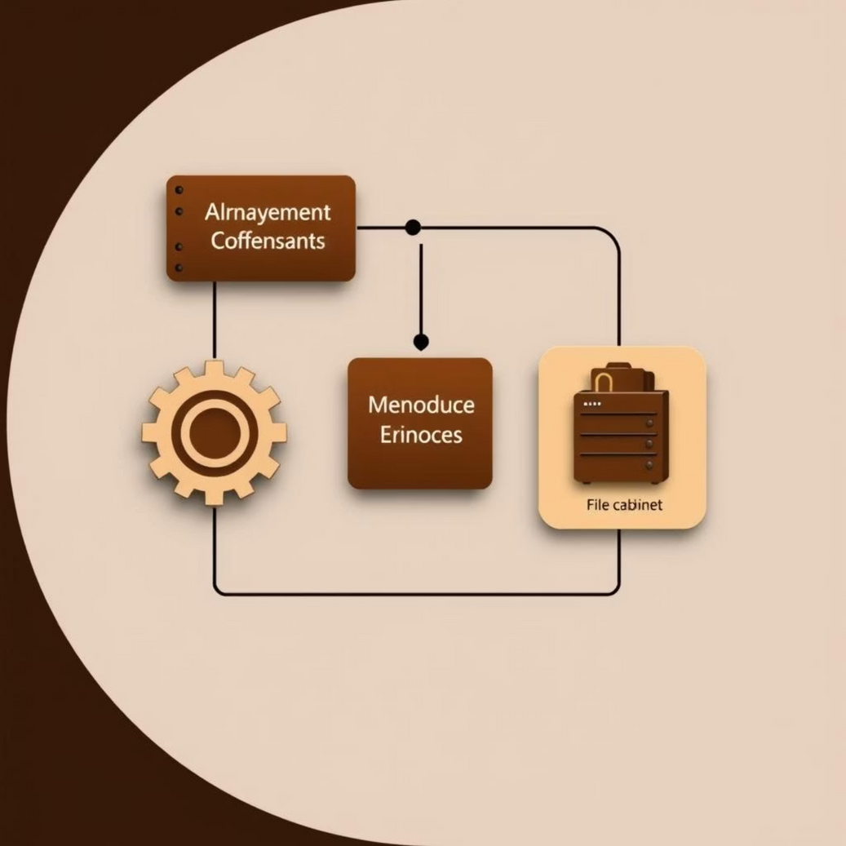
OUR SOLUTION
A Mini OS Kernel: Practical Learning
Our project proposes building a simplified operating system kernel from scratch. This approach offers a controlled environment to implement and test core OS features, directly bridging the gap between theoretical knowledge
and practical application.
This hands-on journey will enhance problem-solving skills and prepare learners for advanced domains like embedded systems, systems programming, and cybersecurity. It transforms abstract ideas into tangible, working components.
Notes:
3

Slide 4
PROJECT ROADMAP
Key Goals and Milestones
Our primary goal is to develop a functional mini OS kernel demonstrating fundamental components in an educational manner. We aim for a modular design, ensuring clarity and extensibility.
1
2
3
Bootloader & Core Kernel Setup
Process Management
Memory Management
Implement process creation, scheduling, and efficient context switching.
Integrate allocation, deallocation, and advanced techniques like paging or segmentation.
Establish a minimal, bootable kernel in a controlled environment like an emulator.
4
5
File System
Refinement & Multilingual CLI
Develop a basic system for creating, storing, and retrieving files.
Enhance stability, modularity, and introduce multilingual command support.
Notes:
4

Slide 5
DEVELOPMENT STRATEGY
Our Approach: Incremental & Modular
We will build the mini OS kernel from scratch, focusing on simplicity and educational value. This approach combines low-level programming with robust testing in emulated environments.
Core Technologies
Modular Design
Assembly Language: For bootloader initialization.
Process Management: Context switching, scheduling, IPC.
C Language: For kernel development, balancing hardware access and abstraction.
Memory Management: Allocation, paging/segmentation.
Emulators (QEMU/Bochs): For safe and hardware-independent testing.
File Management: Basic file operations.
Command Interface: Simple, multilingual CLI for user interaction.
Notes:
5

Slide 6






SYSTEM OVERVIEW
High-Level Architecture
Kernel Core
User Programs
Manages processes, memory, files, commands
Applications requesting services from kernel
Bootloader
System Calls
Hardware HAL
Initializes hardware and loads kernel
Interface between user programs and kernel
Bootloader: Initializes hardware, loads kernel.
Kernel Core: Manages processes, memory, file system, and commands.
System Calls Interface: Bridge between user programs and kernel.
User Programs: Applications running on the OS.
Hardware Abstraction Layer: Interfaces with underlying hardware.
Notes:
6

Slide 7





OUTCOME & IMPACT
Deliverables and Learning Experience
This project will deliver a functional, bootable mini OS kernel. It serves as both a practical tool and a comprehensive learning resource for students and instructors.
Bootable Kernel
Core Modules
A lightweight OS kernel with a custom bootloader, runnable in emulators.
Functional process, memory, and file management modules for hands-on learning.
Multilingual CLI
Documentation
A command-line interface supporting multiple languages, enhancing accessibility.
Detailed system design, implementation guides, and architectural diagrams.
Notes:
7

